Slide 1

Welcome!
Open House
July 19th, 2018
Jessie Burke
jlburke@wcpss.net
(919) 460-3400
www.mrsburkesfirsties.weebly.com

Slide 2

Behavior
This year I will be using a Behavior Chart in our classroom. This is a quick and easy visual representation of the students’ behavior. Each day every child will start out on green which means they are ready to learn. Throughout the day the children will be asked to move their magnet up if they are following our classroom rules or going above and beyond with their behavior. They can also be asked to move down if they are not following the rules. They will have a behavior calendar in their binders, please check this each night.

Slide 3
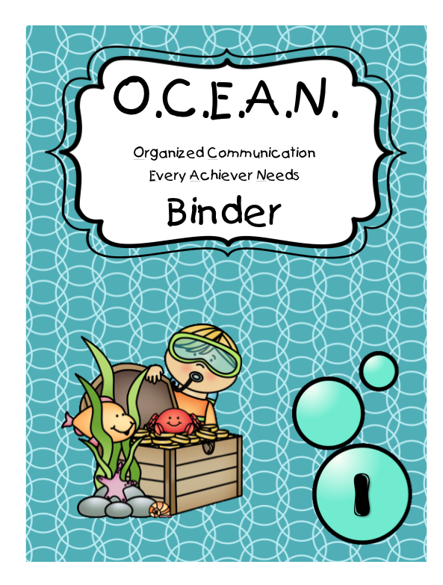
OCEAN binder
***Each Ocean Notebook has rules and procedures inside!

Slide 4

Folders
Homework Folders:
  Kept in Ocean Notebook
  Homework should be done daily
  Homework packet is due back
  and checked on Friday
Friday Folders:
  Completed work is sent home in homework folder
  The work to be kept at home is on the side labeled “Papers to Review and Keep at Home”
  Keep completed work at home

Slide 5

Homework
Homework packets are sent home at the beginning of the week. Homework is to be done nightly and is checked every Friday for completion. Homework will be consistently formatted each week.
Reading with your child every night is essential to their success.
I use homework as part of the student’s work habits grade. Therefore, work habit grades may be affected by missed assignments. All homework should be completed in pencil unless otherwise indicated.

Slide 6

Field Trips
Chaperones will be needed to assist on these trips. Permission forms will inform you of any fees, lunch arrangements, and destinations. You will receive this information prior to our field trips. We ask that paperwork is returned ASAP. In order to chaperone a field trip you must be cleared through the county. Please register ASAP so that you can attend these fun events this year! You MUST register as a
volunteer before OCTOBER.

Slide 7
Testing dates
mClass Testing Schedule:
BOY: July 16-August 3
MOY: December 10-29, January 2-8
EOY: May 8-9, June 5-21
Number Knowledge Test (NKT):
BOY: September 11-24
MOY: January 10-25
EOY: June 6-19

Slide 8
mClass updates
This year, North Carolina implemented new ELA standards. To account for this, all NC schools will be using a new book set for reading benchmarks this year. The books and questions will focus on comprehension, textual evidence, and informational text.
Things to note:
There has been a shift in reading levels
Compared to last year, the oral comprehension questions have become more rigorous resulting in reading levels fluctuating
In order to have a successful year, we need to work together. Please make sure you are reading EVERY night with your child (even on the weekends).
When they are available, new question stems that are more compatible will be sent home along with books. Please utilize these questions every night as your child is reading.

Slide 9

Volunteering
We love to have volunteers throughout the year and we look forward to having you all join our class for field trips and various events. Remember you must be cleared as a volunteer through the volunteer registration system before you can work in the classroom. You can sign up on our classroom computers tonight!

Slide 10

Room Parent Wanted!
We would love to have a room parent for our fabulous year together! The room parent would be responsible for organizing different events and communicating with our other classroom families! If you are interested in this special role, please let me know!

Slide 11
Conferences
Wake County requires two conferences a year.
Conferences are typically at the end of 1st quarter and towards the end of 3rd quarter. We will have student led conferences in the Spring.
More information will be sent home throughout the year!

Slide 12

Report Cards/Interims
Interims are given out in the middle of each quarter to update you on how your child is progressing. Report cards are given at the end of each quarter. The following is the schedule for report cards/and interims.
Quarter 1- Interims go home August 10. Report cards go home October 5.
Quarter 2- Interims go home November 2. Report cards go home January 11.
Quarter 3- Interims go home February 8. Report cards go home April 5.
Quarter 4- Interims go home May 3. Report cards go home June 28.

Slide 13

Important Info
Early Release- Students are dismissed at 1:15. Teachers stay for meetings.
Teacher Workdays- No school for students.
Snow Make-Up Days- Students are dismissed at 12:45

Slide 14

Birthdays
We love to celebrate birthdays and hope to make the day special for your child. If you would like to come celebrate your child’s birthday, celebrations will take place during our recess time from 11:45-12:15. This allows us to have ample time to celebrate and does not take away from instructional time. Only commercially prepared food is allowed per WCPSS Policy. As your child’s birthday is approaching and you wish to celebrate, please just email me prior to the date for confirmation!

Slide 15

Schedule
8:45-9:15 - Arrival
9:15-10:25 - Literacy Block
10:25-10:55 - Lunch
11:00-11:45 - Literacy Block
11:45-12:15 – Recess
12:15-12:25 - Handwriting
12:25-12:55 – Writing
12:55-1:50 – Math
1:50-2:00 – Snack and Read Aloud
2:00-2:40 - Specials
2:40-3:35 – Science and Social Studies
3:35-3:45 - Dismissal

Slide 16

School Arrival
School arrival is from 8:45 am to 9:15 am
Students who arrive to school after the 9:15 am bell must report to the office with a parent to be signed in and to receive a tardy slip.
Students can
NOT be checked
out after 3:15!!

Slide 17
Lunch
Our class lunch is from 10:25am-10:55am
Lunch cost is 2 dollars and 55 cents a day, unless otherwise specified.
If a student does not have a lunch or lunch money, he or she will be provided with free fruit, vegetable and water by the cafeteria.
If your child would like a snack (cookie, chips, ice cream), they must bring extra money.
If you would like to come eat lunch with your child, you may either eat lunch with your child at our assigned table or you may go sit on the picnic tables at the front of the school. If you want to eat outside at the picnic tables you have to sign in using the clipboard in the cafeteria.

Slide 18





Daily 5
Word Work
Read to Someone
Read to Self
Work on Writing
Listen to Reading

Slide 19
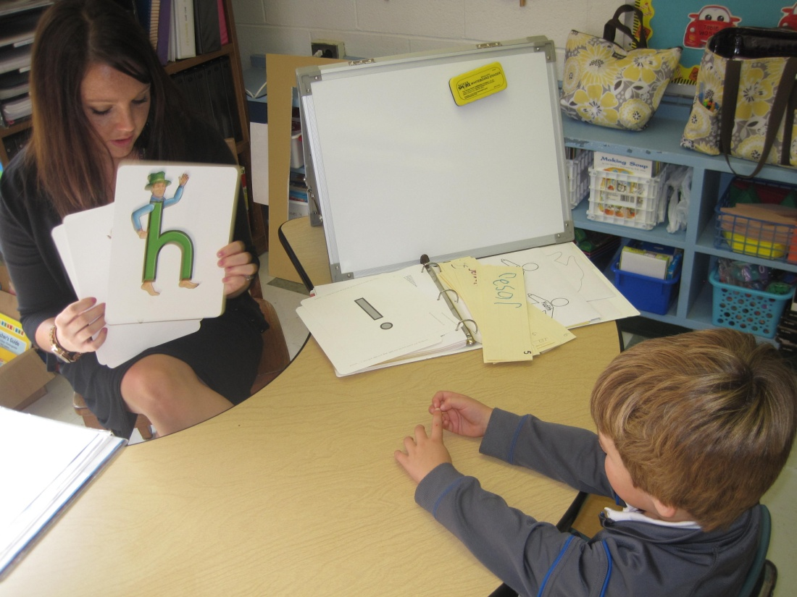
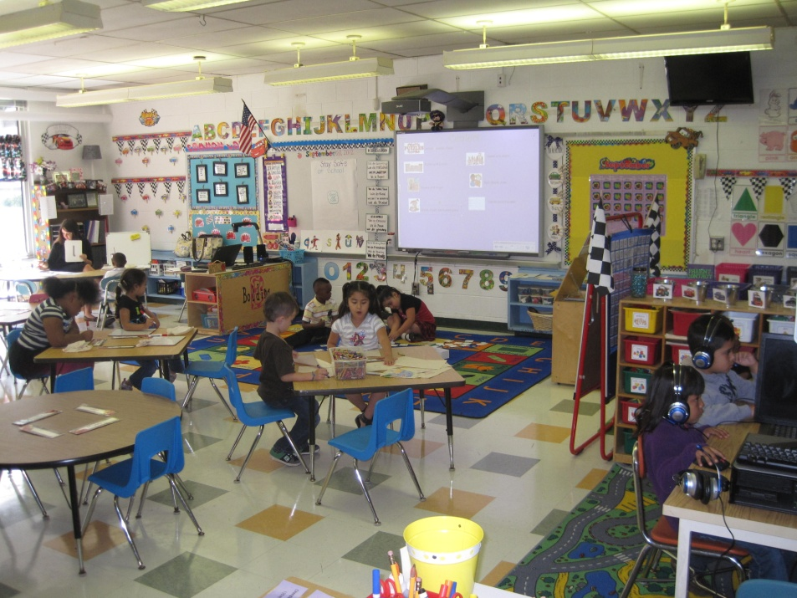
Guided Reading
Students will be pulled in small groups
We will focus on building reading comprehension, reading strategies in various ways and progress in our reading level.
Students will be expected to read fluently and accurately while comprehending the given text.
Students are expected to be reading on a level I to be considered on grade level by the end of the year.

Slide 20



Letterland
The Letterlanders have followed us to first grade! As the characters have remained the same, the program has rigorously increased.
We are continuing to segment words and learning blends, digraphs and trigraphs.
We are constructing words and sentences while “live reading.”
Our spelling words every week derive from the letter land program.

Slide 21

Specials
We attend a daily special from 2:00-2:40!
You can access our specials schedule on our class website under the tab “Class Schedule” as well as in your students binder. On this page you will find a list of our specials for the first quarter. This will be updated throughout the year.

Slide 22
Writing
Narrative writing
Small Moments
Non-fiction writing
“How to” writing
Opinion writing
Poetry
Writing as a researcher
Science and Social Studies Writing

Slide 23
Math
Math Expressions
Read, write and count to 150
Comparing Numbers
Addition
Subtraction
Place Value
Time
Shapes
Money
Data and Measurement

Slide 24
Science/Social Studies
Science
Organisms
Pebbles, sand and silt
Sun, Moon and Stars
Balance and Motion
Social Studies
I am a citizen of many communities
Our community celebrates
Finding my way around my community
We care for our community

Slide 25

Snack
Please send a healthy snack with your child daily. We will have an afternoon snack each day.

Slide 26
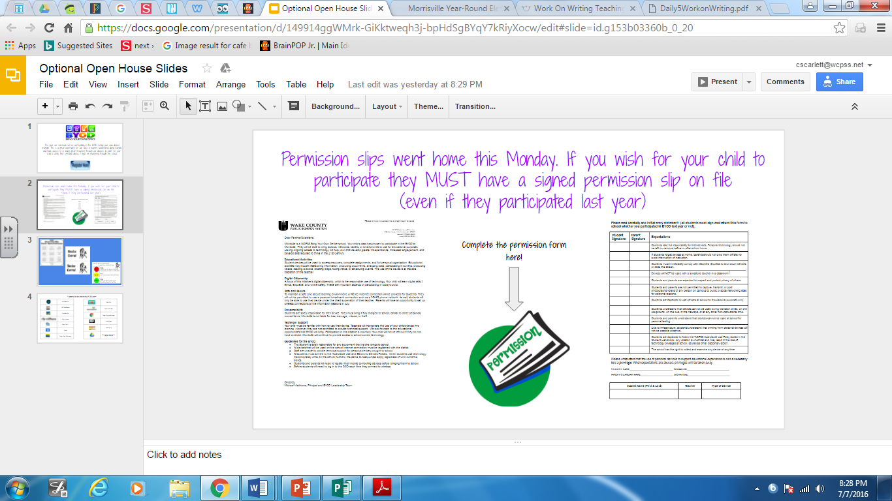
BYOD

Slide 27
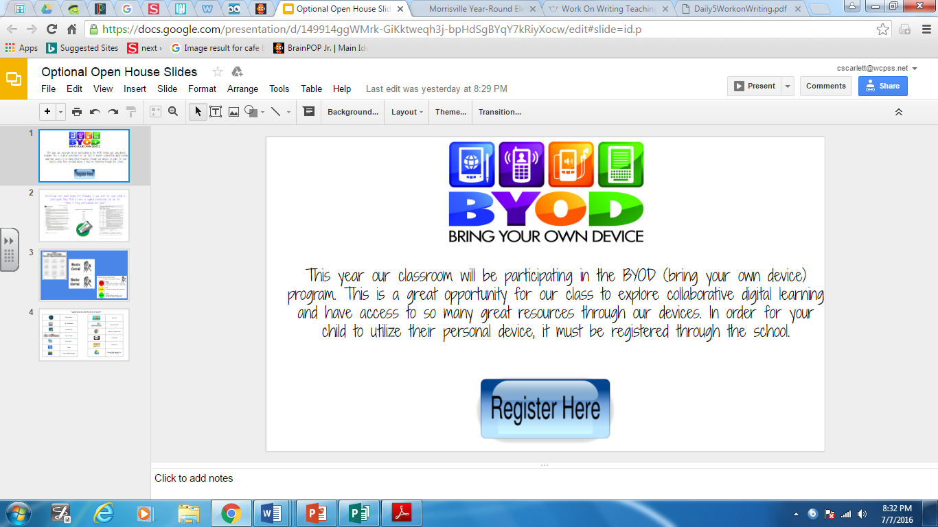
BYOD

Slide 28
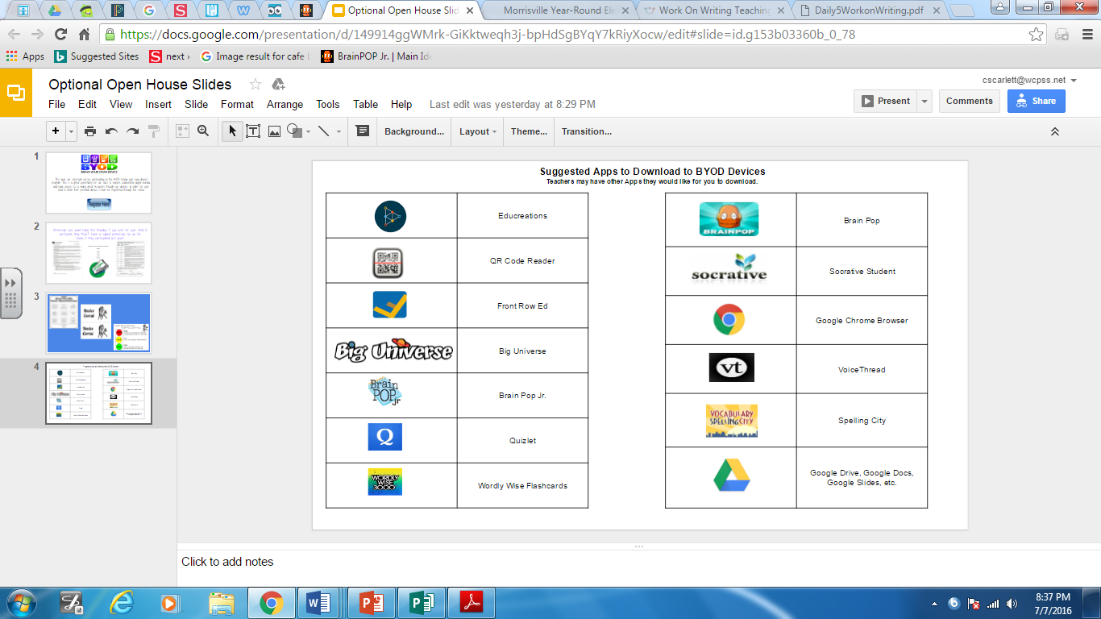
BYOD

Slide 29

Differentiation
level of questioning
groups made from entrance tickets or pretests
technology
remediation and enrichment groups

Slide 30

Instructional Tools/Resources
Thinking Maps
Projection TVs
Chromebooks
iPads
Authentic tasks
Big Universe
Pebble Go
Freckle

Slide 31

Communication
I look forward to working closely with you, as partners, in your child’s education. If at anytime, you have questions or concerns, please let me know. The following are some of the ways that we can communicate on a regular basis throughout the year:
Homework and Friday Folder- Look over the papers and let me know of any concerns.
Classroom News: See what we have been working on at school, mark your calendar for upcoming events, and look for important announcements.
Class Website: Look over the resources, homework, and web links for our class.
Phone- Call or leave a message for me (919) 460-3400
Email-I will respond within 24 hours.
You can e-mail me at
jlburke@wcpss.net
Remind- This is the most reliable way to reach me. If you
are not connected to Remind please let me know,

Slide 32

Policy and Procedures
At your seat, you will find the policy and procedures for Wake County and online you will find the policy and procedures for MES.
Please take the time to read all of the policies and procedures. Most of which were discussed in our presentation tonight!

Slide 33

Thank you for coming!
Any Questions?

